Slide 1
ankita pralhad thorushe enroll no- ebeon0921446413 batch – 6141 project name – restaurant billing system

Slide 2
Content
1.Problem Statement
2.Introduction
3.Features
4.Objectives
5.System Requirements Specification
6.Output
7.Advantages
8.Conclusion

Slide 3
Problem Statement
The billing process is done manually by manpower. It is very much time consuming and also may have some human errors. To overcome this problem, I have come up with this project, that is, “Restaurant Billing System” Using Computer based billing system.

Slide 4
Introduction
The Project Restaurant Billing System Software is for monitoring and controlling the transactions in restaurant.
It is a Window Application designed to help users to maintain and organize restaurant.
System Processes transactions and stores the resulting data. Bill will generated from these data.

Slide 5
Features
The “Restaurant Billing System” or “RBS” is an application to automate the process of information recording and billing of a restaurant.
I contains mainly Two modules.
1.Manage Food – To Enter the food list in menu.
2.Manage Order – To manage Food order and to print the bill for each table.

Slide 6
Admin – Only Admin can enter the food list in menu card and he can only operate this application.
Restaurant Billing System – It is an automated software that can handle restaurant’s bills and gather information about billing history.
Customer – The part of customer is to pay the bill.

Slide 7
Objectives
To provide a computer based billing system for an accurate computation of bills.
To reduce the time, energy, and resources that was being consumed when performing a billing for the customer.
To generate a receipt when performing a service.
To provides a convenient solution of billing pattern.

Slide 8
System Requirents specification
SOFTWARE REQUIREMENTS
Software : Eclipse
Language Used: Core Java
OPERATING SYSTEM:
Windows 10

Slide 9
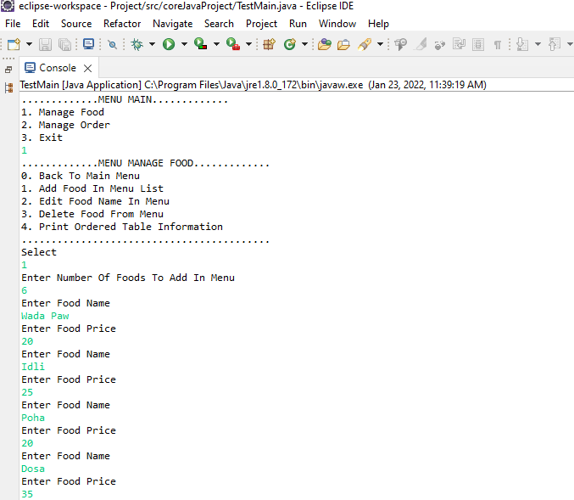
Output
Main Menu to enter the foods items into the menu list.
Fig 1- Main Menu

Slide 10
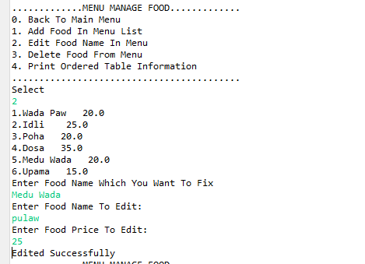
Edit the food name and price.
Fig 2- Edit Menu

Slide 11
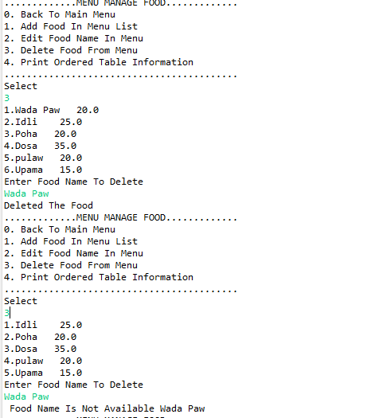
Menu For Delete The Food .
Fig 3 – Delete Menu

Slide 12
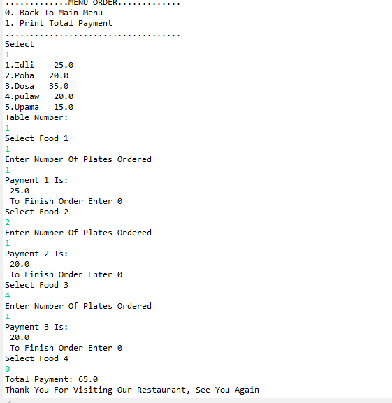
Print Total Bill For Particular Table.
Fig 4 – Table 1 Bill

Slide 13
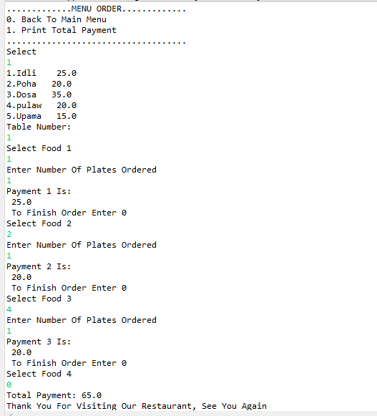
Fig 5 – Table 2 Bill

Slide 14
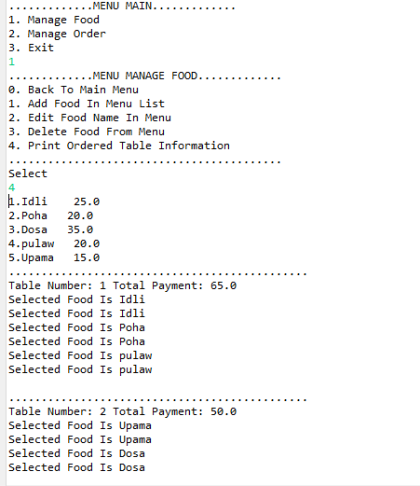
Print Menu – To print bill of all tables.
Fig 6 – Print Menu

Slide 15
Advantages
1.Simple Menu Steps.
2.User Friendly Order Management.
3.Better Customer Service.
4.Easy To Use And Understand.
5. The software will display view of calculations of every transaction.
6.It will generate receipt on every transaction inputted to the system.
7. This project will help the user in fast billing

Slide 16
Conclusion
Restaurant Billing System takes the necessary choice of the customers according to the category of food. It is very good and reliable system which can be in corporate to the chain of hotels so can easily maintained and addressed .

